Slide 1

Software Testing Tutorial
By
Dr. Junaid Akram

Slide 2
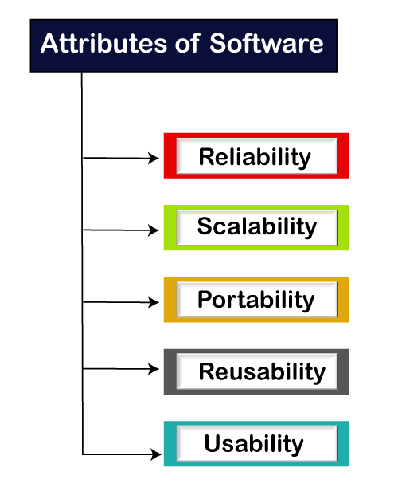

Slide 3
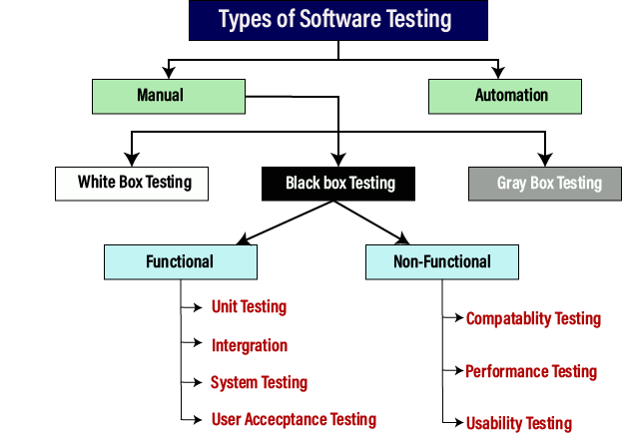
Type of Software testing

Slide 4
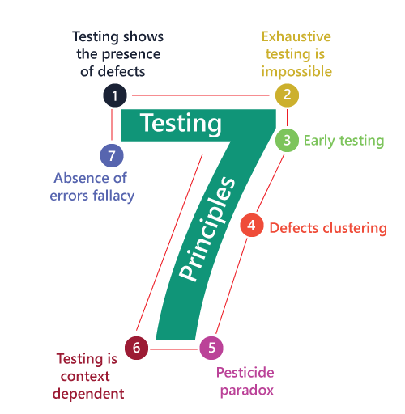
Software Testing Principles
For testing an application or software, we need to follow some principles to make our product defects free, and that also helps the test engineers to test the software with their effort and time.

Slide 5
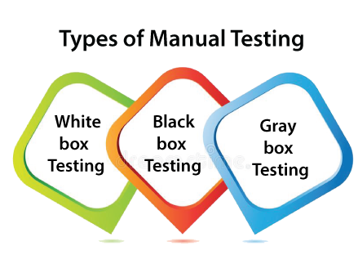
Manual testing
The process of checking the functionality of an application as per the customer needs without taking any help of automation tools is known as manual testing.
While performing the manual testing on any application, we do not need any specific knowledge of any testing tool, rather than have a proper understanding of the product so we can easily prepare the test document.
Manual testing can be further divided into three types of testing, which are as follows:
White box testing
Black box testing
Gray box testing

Slide 6
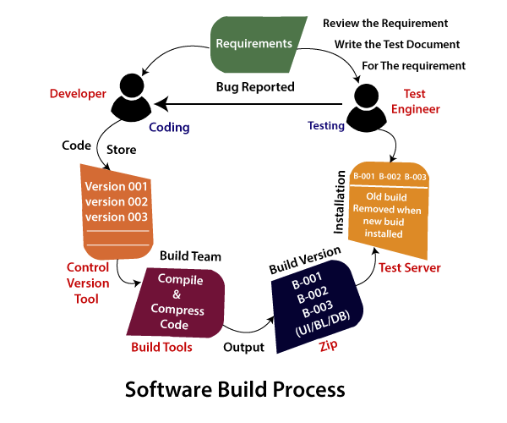
Software Build Process

Slide 7
How to perform Manual Testing
First, tester observes all documents related to software, to select testing areas.
Tester analyses requirement documents to cover all requirements stated by the customer.
Tester develops the test cases according to the requirement document.
All test cases are executed manually by using Black box testing and white box testing.
If bugs occurred then the testing team informs the development team.
The Development team fixes bugs and handed software to the testing team for a retest.

Slide 8
Disadvantages of Manual Testing
It requires a large number of human resources.
It is very time-consuming.
Tester develops test cases based on their skills and experience. There is no evidence that they have covered all functions or not.
Test cases cannot be used again. Need to develop separate test cases for each new software.
Since two teams work together, sometimes it is difficult to understand each other's motives, it can mislead the process.

Slide 9
Advantages of Manual Testing
It does not require programming knowledge while using the Black box method.
It is used to test dynamically changing GUI designs.
Tester interacts with software as a real user so that they are able to discover usability and user interface issues.
It ensures that the software is a hundred percent bug-free.
It is cost-effective.
Easy to learn for new testers.

Slide 10
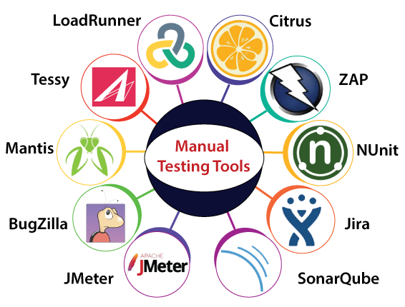
Manual testing tools

Slide 11
Automation testing
Automation testing is a process of converting any manual test cases into the test scripts with the help of automation tools, or any programming language is known as automation testing.
With the help of automation testing, we can enhance the speed of our test execution because here, we do not require any human efforts.
We need to write a test script and execute those scripts.

Slide 12
The life cycle of Automation Testing

Slide 13
Advantages of Automation Testing
Automation testing takes less time than manual testing.
A tester can test the response of the software if the execution of the same operation is repeated several times.
Automation Testing provides re-usability of test cases on testing of different versions of the same software.
Automation testing is reliable as it eliminates hidden errors by executing test cases again in the same way.
Automation Testing is comprehensive as test cases cover each and every feature of the application.
It does not require many human resources, instead of writing test cases and testing them manually, they need an automation testing engineer to run them.
The cost of automation testing is less than manual testing because it requires a few human resources.

Slide 14
Disadvantages of Automation Testing
Automation Testing requires high-level skilled testers.
It requires high-quality testing tools.
When it encounters an unsuccessful test case, the analysis of the whole event is complicated.
Test maintenance is expensive because high fee license testing equipment is necessary.
Debugging is mandatory if a less effective error has not been solved, it can lead to fatal results.

Slide 15
White Box Testing
The white box testing contains various tests, which are as follows:
Path testing
Loop testing
Condition testing
Testing based on the memory perspective
Test performance of the program

Slide 16
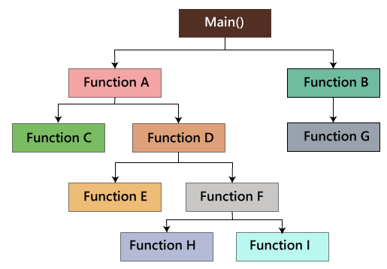
Path Testing
In the path testing, we will write the flow graphs and test all independent paths.
First set the parameters and test if the program is correct in that particular path, and in the same way test all other paths and fix the bugs.

Slide 17
Loop testing
In the loop testing, we will test the loops such as while, for, and do-while, etc. and also check for ending condition if working correctly and if the size of the conditions is enough.
For example: we have one program where the developers have given about 50,000 loops.
We cannot test this program manually for all the 50,000 loops cycle. So we write a small program that helps for all 50,000 cycles,
Test P is written in the similar language as the source code program, this is known as a Unit test.
{
while(50,000)
……
……
}
Test P
{
……
…… }

Slide 18
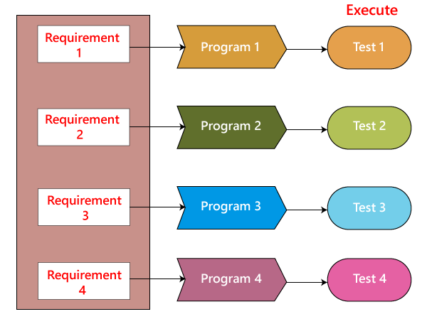
As we can see in the below image that, we have various requirements such as 1, 2, 3, 4. And then, the developer writes the programs such as program 1,2,3,4 for the parallel conditions.

Slide 19
Condition testing
if(condition) - true
{
…..
……
……
}
else - false
{
…..
……
……
}
The above program will work fine for both the conditions, which means that if the condition is accurate, and then else should be false and conversely.

Slide 20
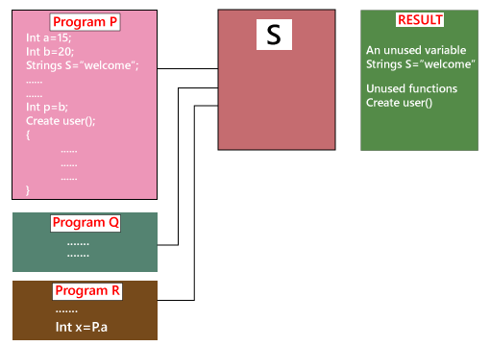
Testing based on the memory (size) perspective
Suppose we have three programs such as Program P, Q, and R, which provides the input to S. And S goes into the programs and verifies the unused variables and then gives the outcome.
After that, the developers will click on several results and call or remove the unnecessary function and the variables.

Slide 21
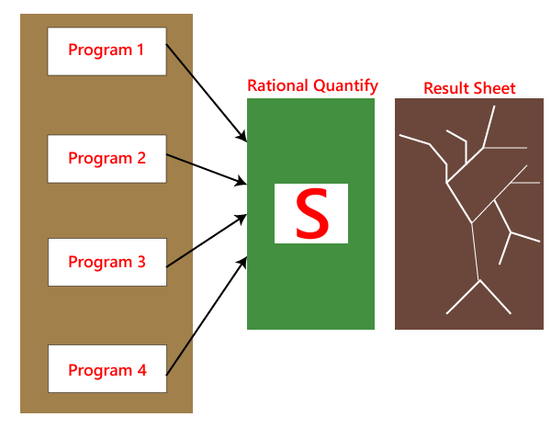
Test the performance (Speed, response time) of the program
The application could be slow for the following reasons:
When logic is used.
For the conditional cases, we will use or & and adequately.
Switch case, we cannot use nested if, instead of using a switch case.

Slide 22
Generic steps of white box testing
Design all test scenarios, test cases and prioritize them according to high priority number.
This step involves the study of code at runtime to examine the resource utilization, not accessed areas of the code, time taken by various methods and operations and so on.
Testing of internal subroutines such as methods, interfaces, that are able to handle all types of data appropriately or not.
This step focuses on testing of control statements like loops and conditional statements to check the efficiency and accuracy for different data inputs.
In the last step white box testing includes security testing to check all possible security loopholes by looking at how the code handles security.

Slide 23
Advantages of White box testing
White box testing optimizes code so hidden errors can be identified.
Test cases of white box testing can be easily automated.
This testing is more thorough than other testing approaches as it covers all code paths.
It can be started in the SDLC phase even without GUI.

Slide 24
Disadvantages of White box testing
White box testing is too much time consuming when it comes to large-scale programming applications.
White box testing is much expensive and complex.
It can lead to production error because it is not detailed by the developers.
White box testing needs professional programmers who have a detailed knowledge and understanding of programming language and implementation.

Slide 25
Techniques Used in White Box Testing
Data Flow Testing | Data flow testing is a group of testing strategies that examines the control flow of programs in order to explore the sequence of variables according to the sequence of events.
Control Flow Testing | Control flow testing determines the execution order of statements or instructions of the program through a control structure. The control structure of a program is used to develop a test case for the program. In this technique, a particular part of a large program is selected by the tester to set the testing path. Test cases represented by the control graph of the program.
Branch Testing | Branch coverage technique is used to cover all branches of the control flow graph. It covers all the possible outcomes (true and false) of each condition of decision point at least once.
Statement Testing | Statement coverage technique is used to design white box test cases. This technique involves execution of all statements of the source code at least once. It is used to calculate the total number of executed statements in the source code, out of total statements present in the source code.
Decision Testing | This technique reports true and false outcomes of Boolean expressions. Whenever there is a possibility of two or more outcomes from the statements like do while statement, if statement and case statement (Control flow statements), it is considered as decision point because there are two outcomes either true or false.

Slide 26
Difference between white-box testing and black-box testing
White-box testing | Black box testing
The developers can perform white box testing. | The test engineers perform the black box testing.
To perform WBT, we should have an understanding of the programming languages. | To perform BBT, there is no need to have an understanding of the programming languages.
In this, we will look into the source code and test the logic of the code. | In this, we will verify the functionality of the application based on the requirement specification.
In this, the developer should know about the internal design of the code. | In this, there is no need to know about the internal design of the code.

Slide 27
Black box testing
Black box testing is a technique of software testing which examines the functionality of software without peering into its internal structure or coding.

Slide 28
Generic steps of black box testing
The black box test is based on the specification of requirements, so it is examined in the beginning.
In the second step, the tester creates a positive test scenario and an adverse test scenario by selecting valid and invalid input values to check that the software is processing them correctly or incorrectly.
In the third step, the tester develops various test cases such as decision table, all pairs test, error estimation, cause-effect graph, etc.
The fourth phase includes the execution of all test cases.
In the fifth step, the tester compares the expected output against the actual output.
In the sixth and final step, if there is any flaw in the software, then it is cured and tested again.

Slide 29
Test procedure
The test procedure of black box testing is a kind of process in which the tester has specific knowledge about the software's work, and it develops test cases to check the accuracy
It does not require programming knowledge of the software.
All test cases are designed by considering the input and output of a particular function
Test cases
Test cases are created considering the specification of the requirements.
These test cases are generally created from working descriptions of the software including requirements, design parameters, and other specifications.
For the testing, the test designer selects both positive test scenario by taking valid input values and adverse test scenario by taking invalid input values to determine the correct output.
Test cases are mainly designed for functional testing but can also be used for non-functional testing.

Slide 30
Techniques Used in Black Box Testing
Decision Table Technique | Decision Table Technique is a systematic approach where various input combinations and their respective system behavior are captured in a tabular form. It is appropriate for the functions that have a logical relationship between two and more than two inputs.
Boundary Value Technique | Boundary Value Technique is used to test boundary values, boundary values are those that contain the upper and lower limit of a variable. It tests, while entering boundary value whether the software is producing correct output or not.
State Transition Technique | State Transition Technique is used to capture the behavior of the software application when different input values are given to the same function. This applies to those types of applications that provide the specific number of attempts to access the application.
All-pair Testing Technique | All-pair testing Technique is used to test all the possible discrete combinations of values. This combinational method is used for testing the application that uses checkbox input, radio button input, list box, text box, etc.
Equivalence Partitioning Technique | A technique in which input data divided into partitions of valid and invalid values, and it is mandatory that all partitions must exhibit the same behavior.
Error Guessing Technique | Error guessing is a technique in which there is no specific method for identifying the error. It is based on the experience of the test analyst, where the tester uses the experience to guess the problematic areas of the software.
Use Case Technique | Use case Technique used to identify the test cases from the beginning to the end of the system as per the usage of the system. By using this technique, the test team creates a test scenario that can exercise the entire software based on the functionality of each function from start to end.

Slide 31
GreyBox Testing
Greybox testing is a software testing method to test the software application with partial knowledge of the internal working structure. It is a combination of black box and white box testing because it involves access to internal coding to design test cases as white box testing and testing practices are done at functionality level as black box testing.

Slide 32
Why GreyBox testing?

Slide 33
Generic Steps to perform Grey box Testing are:
First, select and identify inputs from BlackBox and WhiteBox testing inputs.
Second, Identify expected outputs from these selected inputs.
Third, identify all the major paths to traverse through during the testing period.
The fourth task is to identify sub-functions which are the part of main functions to perform deep level testing.
The fifth task is to identify inputs for subfunctions.
The sixth task is to identify expected outputs for subfunctions.
The seventh task includes executing a test case for Subfunctions.
The eighth task includes verification of the correctness of result.

Slide 34
Techniques of Grey box Testing
Matrix Testing
This testing technique comes under Grey Box testing. It defines all the used variables of a particular program. In any program, variable are the elements through which values can travel inside the program.
Matrix technique is a method to remove unused and uninitialized variables by identifying used variables from the program.
Regression Testing
Regression testing is used to verify that modification in any part of software has not caused any adverse or unintended side effect in any other part of the software.
During confirmation testing, any defect got fixed, and that part of software started working as intended, but there might be a possibility that fixed defect may have introduced a different defect somewhere else in the software.
So, regression testing takes care of these type of defects by testing strategies like retest risky use cases, retest within a firewall, retest all, etc.

Slide 35
Orthogonal Array Testing or OAT The purpose of this testing is to cover maximum code with minimum test cases. Test cases are designed in a way that can cover maximum code as well as GUI functions with a smaller number of test cases.
Pattern Testing
Pattern testing is applicable to such type of software that is developed by following the same pattern of previous software. In these type of software possibility to occur the same type of defects. Pattern testing determines reasons of the failure so they can be fixed in the next software.
Usually, automated software testing tools are used in Greybox methodology to conduct the test process. Stubs and module drivers provided to a tester to relieve from manually code generation.

Slide 36
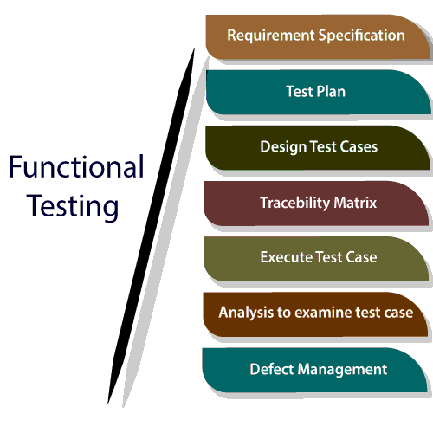
Functional Testing

Slide 37
What to test in functional testing?
The main objective of functional testing is checking the functionality of the software system. It concentrates on:
Basic Usability: Functional Testing involves the usability testing of the system. It checks whether a user can navigate freely without any difficulty through screens.
Accessibility: Functional testing test the accessibility of the function.
Mainline function: It focuses on testing the main feature.
Error Condition: Functional testing is used to check the error condition. It checks whether the error message displayed.

Slide 38
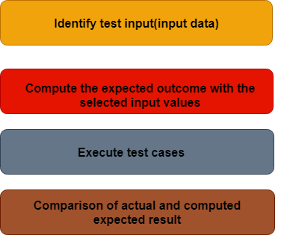
Process to perform functional testing
There are the following steps to perform functional testing:
There is a need to understand the software requirement.
Identify test input data
Compute the expected outcome with the selected input values.
Execute test cases
Comparison between the actual and the computed result

Slide 39
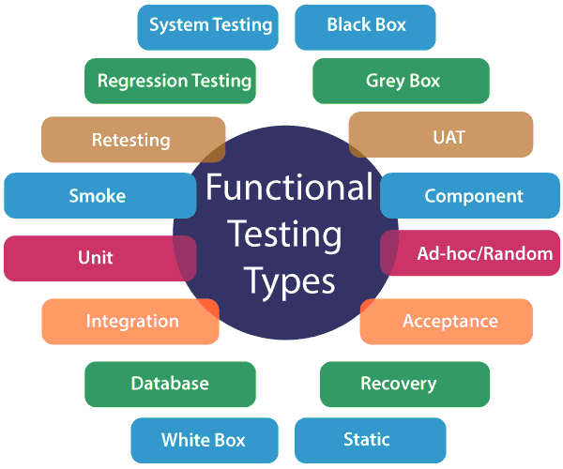
Types of functional testing
https://www.javatpoint.com/functional-testing

Slide 40
Advantages of Functional Testing
It produces a defect-free product.
It ensures that the customer is satisfied.
It ensures that all requirements met.
It ensures the proper working of all the functionality of an application/software/product.
It ensures that the software/ product work as expected.
It ensures security and safety.
It improves the quality of the product.

Slide 41
Disadvantages of functional testing
Functional testing can miss a critical and logical error in the system.
This testing is not a guarantee of the software to go live.
The possibility of conducting redundant testing is high in functional testing.

Slide 42
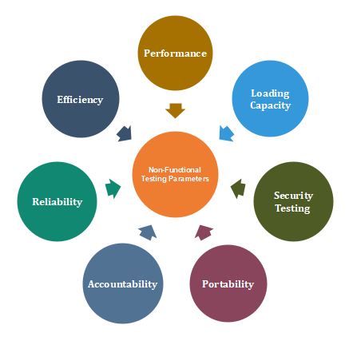
Non-Functional Testing
https://www.javatpoint.com/non-functional-testing

Slide 43
Advantages of Non-functional testing
It provides a higher level of security. Security is a fundamental feature due to which system is protected from cyber-attacks.
It ensures the loading capability of the system so that any number of users can use it simultaneously.
It improves the performance of the system.
Test cases are never changed so do not need to write them more than once.
Overall time consumption is less as compared to other testing processes.

Slide 44
Disadvantages of Non-Functional Testing
Every time the software is updated, non-functional tests are performed again.
Due to software updates, people have to pay to re-examine the software; thus software becomes very expensive.

Slide 45
Difference between Automation Testing and Manual Testing
Aspects | Automation testing | Manual testing
Definition | When an application or software is tested with the help of some tools is known as automation testing. | It is a type of software testing, which is done by the test Engineer to check the functionality of an application based on the customer requirement.
Reliability | It is reliable because it tests the application with the help of tools and test scripts. | It is not reliable because there is a possibility of human error, which may not be delivered the bug-free application.
Reused | The script can be reused across multiple releases. | It could be possible when the test case only needs to run once or twice.
Batch Execution | Batch execution is possible using automation testing because all the written scripts can be executed parallelly or simultaneously. | Batch execution is not possible in manual testing.
Time-saving | The execution is always faster than the manual; that's why the automation testing process is time-saving. | It is time consuming due to the usage of the human resources.
Investment | While using the Automation tool, investment is required. | Human resources needed investment.
Performance testing | To test the performance of the application with the help of load and stress testing, automation test engineer needs to perform Performance Testing. | In manual testing, performance testing is not possible.
Programming knowledge | Without having an understanding of programming language, we cannot write the test script. | There is no need to know programming language but should have the product knowledge to write the test case.
Framework | The automation test engineer can use the different types of frameworks like Data driven, Hybrid, modular driven, and keyword-driven to faster the automation process. | There is no need for a framework while using manual testing.
Operating system compatibility | Automation testing can also be performed on different systems with different operating system platforms and various programming languages. | Operating system compatibility is not possible in manual testing because the different tester is required to perform such tasks.
Regression testing | Whenever the code changes happen due to the enhancement of the release, then automation test engineer performs the regression testing. | When the test engineer executes the test case for the first time, it may be useful, but there is a possibility that it will not catch the regression bugs because of changing requirements frequently.

Slide 46
Static Testing
Static testing is testing, which checks the application without executing the code. It is a verification process. Some of the essential activities are done under static testing such as business requirement review, design review, code walkthroughs, and the test documentation review.
Static testing is performed in the white box testing phase, where the programmer checks every line of the code before handling over to the Test Engineer.
Static testing can be done manually or with the help of tools to improve the quality of the application by finding the error at the early stage of development; that why it is also called the verification process.

Slide 47
Dynamic Testing
Dynamic testing is testing, which is done when the code is executed at the run time environment. It is a validation process where functional testing [unit, integration, and system testing] and non-functional testing [user acceptance testing] are performed.
We will perform the dynamic testing to check whether the application or software is working fine during and after the installation of the application without any error.

Slide 48
Static testing | Dynamic testing
In static testing, we will check the code or the application without executing the code. | In dynamic testing, we will check the code/application by executing the code.
Static testing includes activities like code Review, Walkthrough, etc. | Dynamic testing includes activities like functional and non-functional testing such as UT (usability testing), IT (integration testing), ST (System testing) & UAT (user acceptance testing).
Static testing is a Verification Process. | Dynamic testing is a Validation Process.
Static testing is used to prevent defects. | Dynamic testing is used to find and fix the defects.
Static testing is a more cost-effective process. | Dynamic testing is a less cost-effective process.
This type of testing can be performed before the compilation of code. | Dynamic testing can be done only after the executables are prepared.
Under static testing, we can perform the statement coverage testing and structural testing. | Equivalence Partitioning and Boundary Value Analysis technique are performed under dynamic testing.
It involves the checklist and process which has been followed by the test engineer. | This type of testing required the test case for the execution of the code.

Slide 49

Thanks for your attention!
Any Question?
Email me on : junaid.akram@xmu.edu.my

